Slide 1
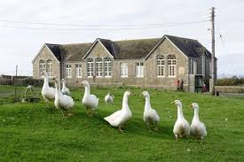
Monday 9th July to Friday 13th July 2018

Slide 2
We really would like as many of the children to come as possible
Enriching experiencing
Team building
Social strategies

Slide 3
Location
Background Information Carnyorth Outdoor Education Centre is situated in West Cornwall between St Just and Pendeen.
Originally built in 1893 as a village school for mining families
This area of Cornwall is wild and wonderful and within walking distance there are wild moors, a Bronze Age stone circle, World Heritage mining remains including the much visited and well played in restored mining tunnels.

Slide 4
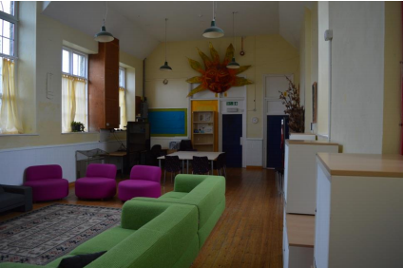

Slide 5
Two large dormitories, one with 12 bunks and one with 14
There is a large common room and separate dining room.
Large kitchen for catering
Enclosed, secure outside area

Slide 6
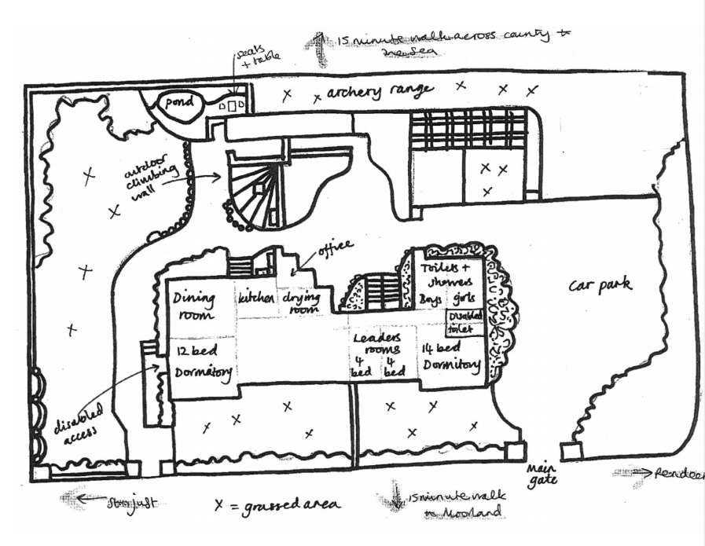

Slide 7
Activities
Activities
Canoeing and Kayaking
Climbing
Build and cruise a coracle
Archery
Orienteering
Mountain Biking
Search and Rescue
Wonderful Wild Woodland
Miners Cluedo
Rock Pool World
Local Exploration
Pizza making and baking
Shelter Building
http://www.cornwalloutdoors.org/media/2064/carnyorth-brochure-2017.pdf

Slide 8
Catering
First day: packed lunch from home
Cake or biscuits for evening snack.
Typical menu
Breakfast
Cereal / toast / yoghurt/fruit
Lunch
Sandwiches / crisp/ fruit/ snack bar
Evening meal
Sausage and chips / cottage pie / pasta bake

Slide 9
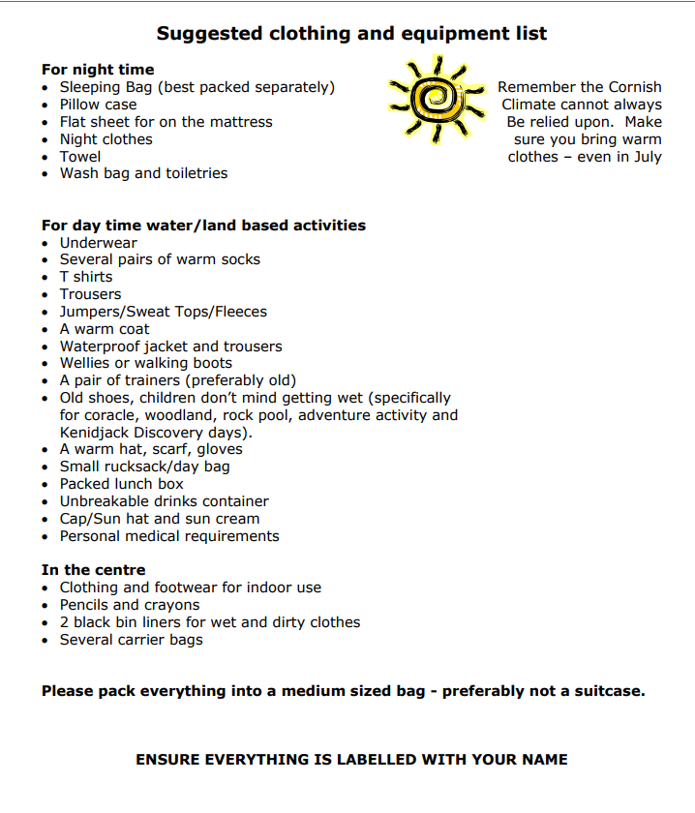
Please note that no extra spending money is required.
No phones or electronic devices

Slide 10
Behaviour is of paramount importance for everyone’s enjoyment and safety
Unfortunately, if a child’s behaviour threatens the enjoyment or safety of other children they will need to be collected from the centre.

Slide 11
Costing
Cost as low as possible
Total cost £230
£185 centre
£45 for food and travel
A non-refundable deposit of £30.00 due by Friday 23rd February 2018
Second payment of £40.00 due on Friday 23rd March 2018
Third payment of £40.00 due on Friday 20th April 2018
Fourth payment of £40.00 due on Friday 18th May 2018
Fifth payment of £40.00 due on Friday 8th June 2018
Final payment of £40:00 due on Tuesday 3rd of July 2018

Slide 12
Anyone who can help with rice pots / pasties
Volunteer driver for a van

